Slide 1
Implementation of BasicMed in the United States
Brent Blue MD
FAA Senior Aviation Medical Examiner
Jackson Hole, Wyoming USA

Slide 2
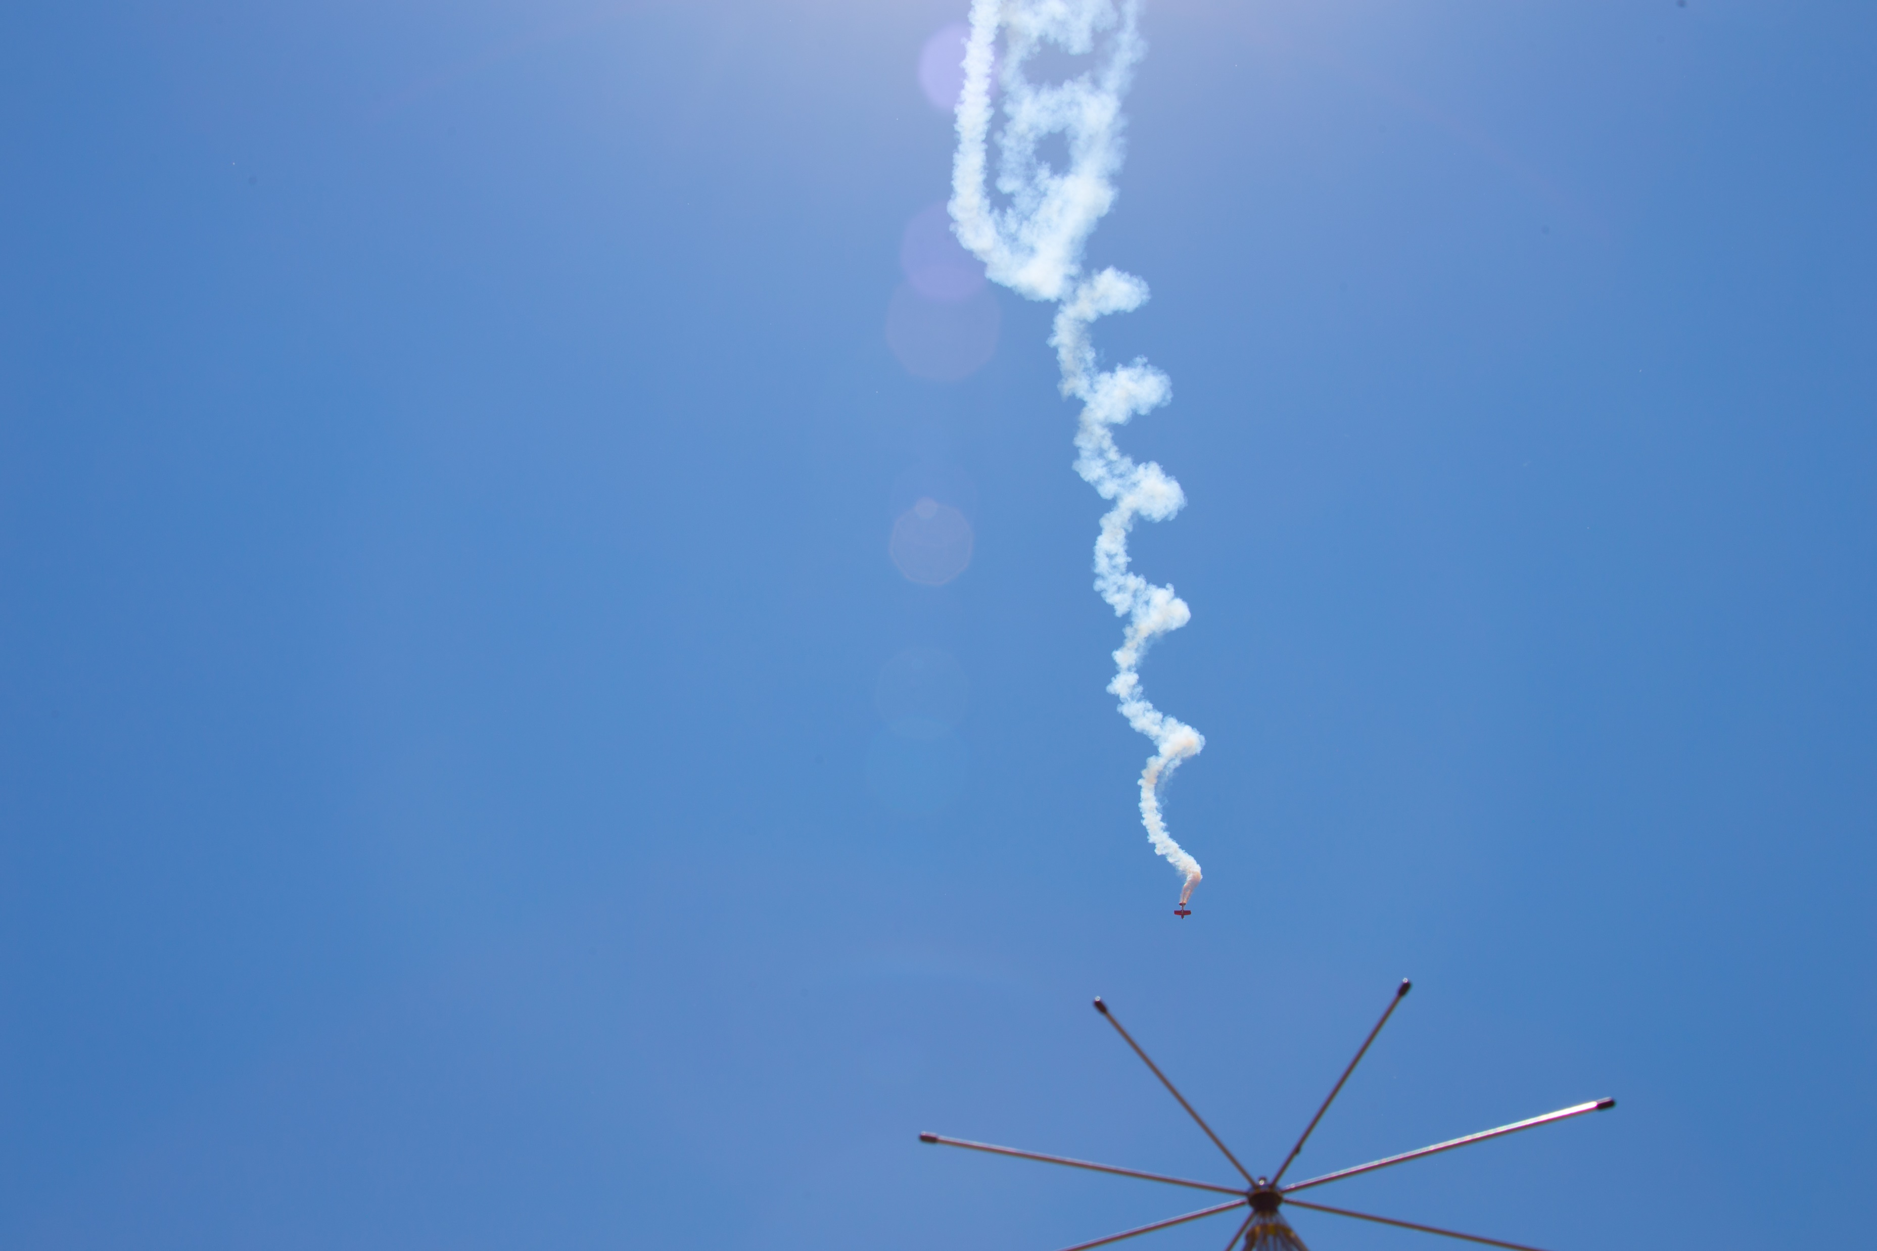
BasicMed Implementation
Pilot Familiarization
Understanding the rules
Separation from Third Class Medicals and Sport Pilot (Driver’s License)
Why BasicMed?
Physician Familiarization
Understanding the physical exam
Understanding the liability
Filtering out the misinformation

Slide 3
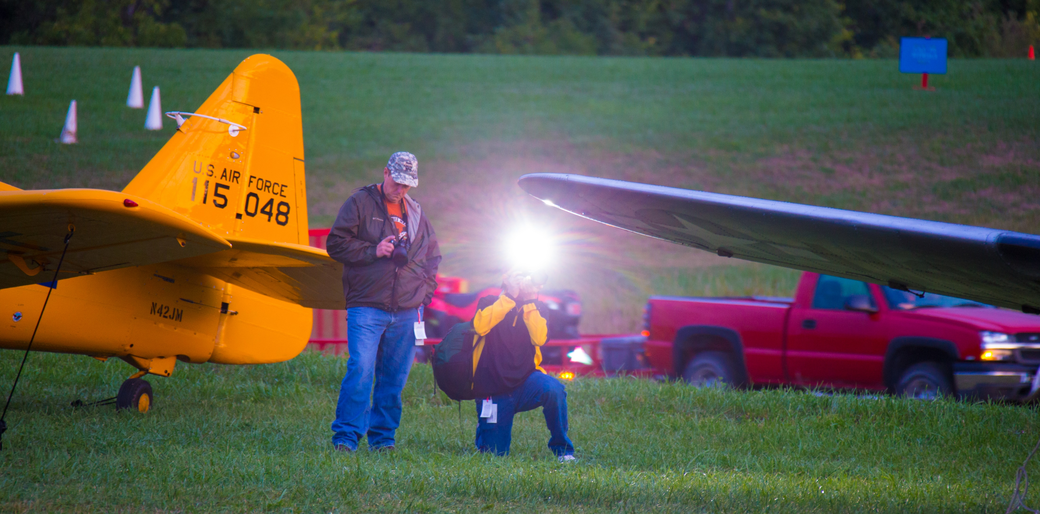
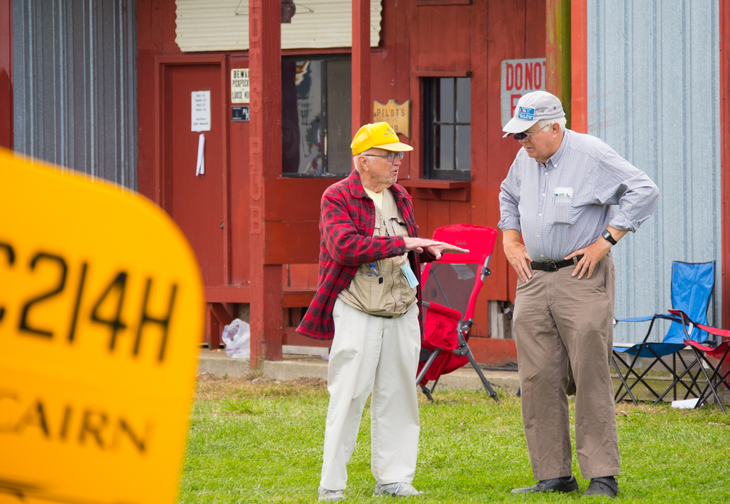
BasicMed Implementation
Why BasicMed?
Are pilots trying to hide something?
Good medicine versus the FAA’s requirements
CACI—Conditions AME’s Can Issue
Special Issuance—Look at the requirements

Slide 4
BasicMed Implementation
No evidence that BasicMed pilots have more accidents or incidents
Lots of misinformation being projected in the public

Slide 5
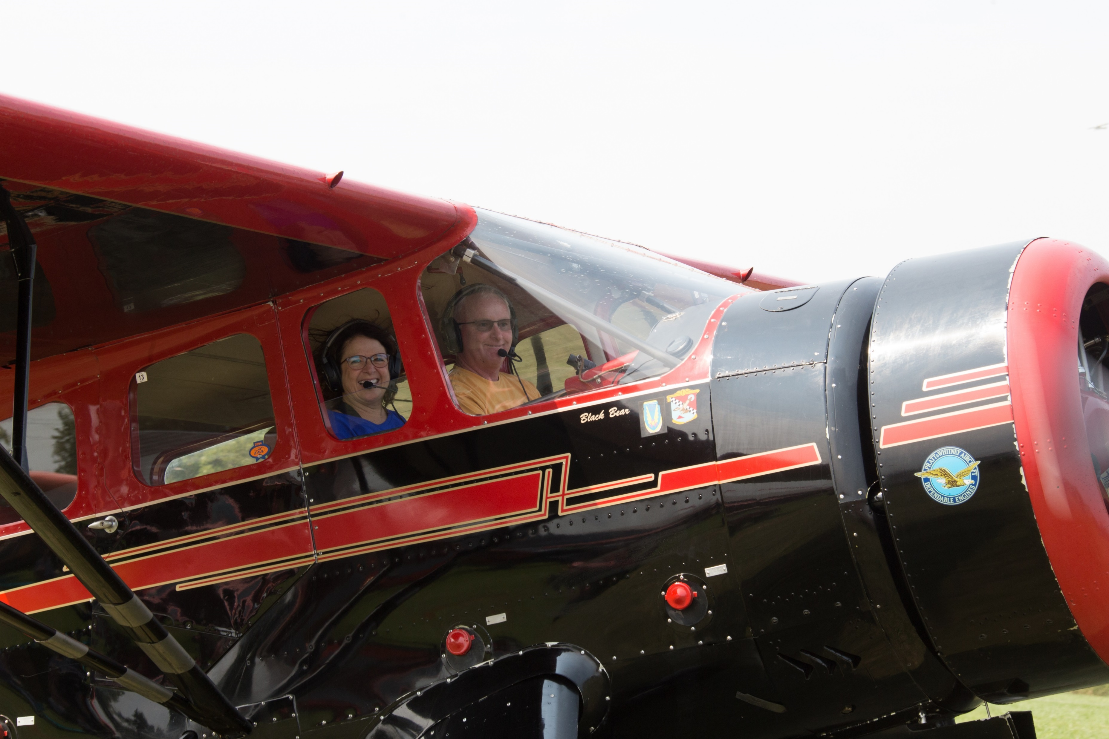
BasicMed Implementation
25,000 Pilots plus since May 1, 2017
Great acceptance by pilots and non AME physicians (AOPA listing)
AOPA and Mayo Clinic have online courses

